Slide 1
CS 4530: Fundamentals of Software Engineering Lesson 6.3: Teams
Adeel Bhutta, Jan Vitek and Mitch Wand
Khoury College of Computer Sciences
© 2022 Released under the CC BY-SA license

Slide 2
Learning Goals for this Lesson
At the end of this lesson, you should be able to
Understand why agile processes favor small teams
Describe the HRT pillars of social interaction
Explain the importance of sharing information with your team
Understand how to do a blameless post-mortem
of a failure.
Notes:
<read slide>
[Ask students to share experiences good and bad of working in teams]

Slide 3
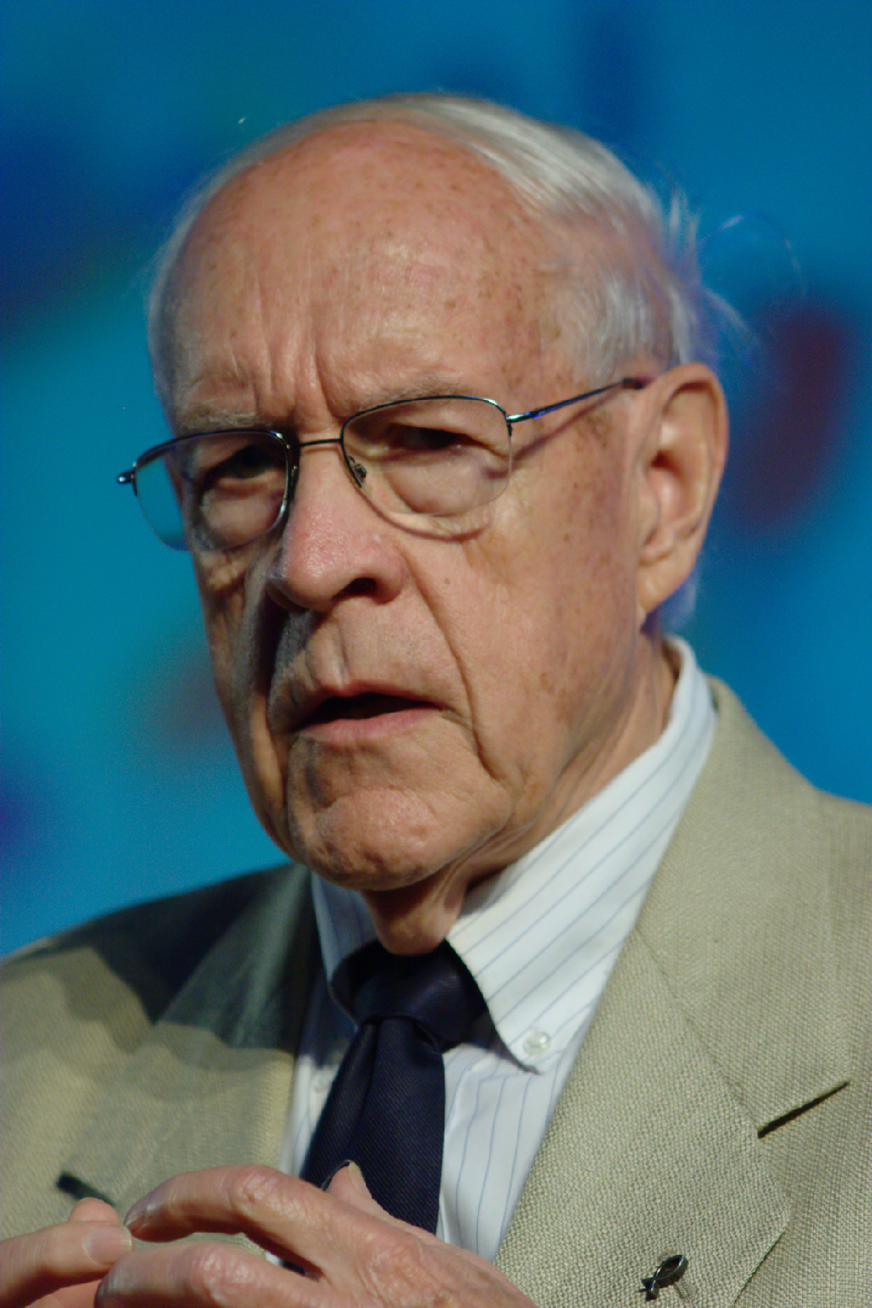
Teams are hard: Brooks’ Law
“Adding manpower to a late software project makes it later”
Fred Brooks, 1975
Notes:
In the 70’s, a prominent software engineer named Fred Brooks analyzed software construction failures, coining Brooks’ Law: “Adding manpower to a late software project makes it later.” He talked a lot about the problems that software engineers faced at the time.
The core thesis behind his book “The mythical man month” is that it’s a myth to estimate software construction in terms of person-months. This is because complex projects can never be perfectly partitioned into discrete chunks that can be worked on independently.
Hence, when adding more team members, you also increase the amount of communication necessary across team members, making your overall development speed slower, not faster.
If you’ve been following along in the Software Engineering @ Google book this semester, you have likely found that one of the recurring themes in THAT book is to design processes that scale sub-linearly with the size of your team or the scale of your software: that is, to get around Brooks’ law.

Slide 4
What goes wrong with teams in software development?
How do you structure teams effectively?
How do you encourage team-members to treat each other well?
How do you encourage teams to share knowledge and collaborate?
How do you respond to failures?
Notes:
(Read slide of common team issues)
One of the core agile principles that we’ve been talking about this week is: connecting what we are doing to the ultimate value that we are delivering to our customers. By understanding why team processes are setup like they are, hopefully you can understand better the value that those processes provide – and maybe you can even help your or your manager reflect on and improve their existing processes.

Slide 5

How do we structure teams efficiently?
Examining Brooks’ Law: “Adding manpower to a late software project makes it later”
How many communication links are needed to finish a task?
Notes:
The first question/challenge that we will look at is: how to structure teams efficiently?
How big should a team be?
If you take a small team size of, say, six. That’s 15 links between everyone.
Double that group for a team of 12. That shoots up to 66 links.
A small business of 50 people has an incredible 1,225 links to manage.
The cost of coordinating, communicating, and relating with each other snowballs to such a degree that it lowers individual and team productivity.
This is the rationale for Brooks’ law.
Hence, our first lesson for how to structure teams effectively is: keep them small.

Slide 6

Agile Favors “Two-Pizza” Teams
Q: How many people on a team?
A: “No more than you could feed with two pizzas”
Rationale:
Decrease communication burdens
Focus conversations to relevant topics
Notes:
A common way to refer to these “small” teams is to think about it in terms of how big of a meeting you will have when you bring your whole team together.
Imagine having a Scrum meeting with 6 team members. In your 15 minutes, each team member gets about 2 minutes to share what they did since the last meeting, what they are doing, and so on. You can have a meaningful interaction, where problems are shared and solutions identified.
Now imagine that same meeting, but with a team of 20. In your 15 minutes, each team member gets less than a minute to share the same. How can you effectively have the same meaningful interaction?
Oh, just make the meeting longer, they say. Make it 40 minutes – then everyone still gets 2 minutes! But now, in addition to using up much more of each person’s day, you risk losing focus: are all 20 team members really going to be able to make an effective contribution to help each other on their tasks?
So: two pizza teams

Slide 7
Encourage team members to treat others well? Three Pillars of Social Skills
Pillar 1: Humility: You are not the center of the universe (nor is your code!). You’re neither omniscient nor infallible. You’re open to self-improvement.
Pillar 2: Respect: You genuinely care about others you work with. You treat them kindly and appreciate their abilities and accomplishments.
Pillar 3: Trust: You believe others are competent and will do the right thing, and you’re OK with letting them drive when appropriate.
From “Debugging Teams” by Ben Collins-Sussman and Brian Fitzpatrick
Notes:
How can we encourage team members to treat each other well? It’s probably a good idea to have some ground rules for interactions between team members.
Here’s a set of ground rules taken from the book “Debugging Teams” – written by two long-time software team leads at Google.
Both of the authors trace almost every social conflict that they have witnessed in their orgs back to a lack of one of these three traits.
This lens (HRT, pronounced “heart”) is useful for evaluating all kinds of personal conflicts. We work with others, and will be most effective when we can create long-lasting relationships with our colleagues who will be able to help us out later when we need. For example: nobody wants to work with someone who consistently behaves like they are the smartest person in the room. Give and receive constructive criticism.
Humility – it’s fun to be the most knowledgeable person in the room, and mentoring others can be rewarding. It is easy to get addicted to being the lead on projects – you start out as the person who knows the most about something. But, eventually you will need to change directions and get exposed to new things. Once you reach a local maximum on your team, you stop learning. And then you get bored. Put yourself outside of your comfort zone, and be open to trying new things that you are less confident about. Be willing to show some weakness.
Respect – You will need to criticize and give feedback on someone’s work while recognizing their strengths.
Trust – Might feel hard at first if you have been burned many times by team-mates who you delegated something to and who were, simply put, incompetent. Requires a two-way commitment. Trust that you can delegate something to someone else, and that they will have the respect and humility to ask for help if needed.

Slide 8
HRT Example: Code Review
This is personal
Is this really that black and white?
“Man, you totally got the control flow wrong on that method there. You should be using the standard foobar code pattern like everyone else”
Are we demanding a specific change?
Everyone else does it right,
therefore you are stupid
From “Debugging Teams” by Ben Collins-Sussman and Brian Fitzpatrick
Notes:
Read code review comment. Ask students how they would feel if they got this feedback. Ask them why they would feel that way.
Then do the builds and talk through each part that is problematic, and how it violates HRT
“You” – Violates respect. This is making it personal. Show respect for others.
“wrong” – Violates humility. This assumes that there is a clear “wrong” here. Is it wrong, or is there instead something else we could say to describe what we think is wrong?
“using the standard…” – Violates humility again. Are we demanding a SPECIFIC changes? Not only is the existing way wrong, but there is a CLEAR right way? How often does that really come up in software development?
“everyone else” – makes clear that the reviewer doesn’t trust the person who wrote the code. How can we move forward with out trust?
This is not a productive comment because the response is going to be overly emotional, coming from someone who was put on the defense
<Brainstorm: "If you had a bad team experience in the past, can you explain it in terms of these three pillars?”>

Slide 9
HRT Example: Code Review
“Man, you totally got the control flow wrong on that method there. You should be using the standard foobar code pattern like everyone else”
“Hmm, I’m confused by the control flow in this section here. I wonder if the foobar code pattern might make this clearer and easier to maintain?
Humility! This is about me, not you
From “Debugging Teams” by Ben Collins-Sussman and Brian Fitzpatrick
Notes:
Read the new comment. Ask students what they think about this? How is it better?
(build to highlight the humility aspect)
The suggestion overall is: Don’t outright say that the other person is wrong: you are just having trouble understanding it. Could be your fault or theirs. Not demanding any specific change, but suggest something that might help improve. No discussion of the author’s value or coding skills.
Prof. Wand says: I had a mentor once who was a master at asking the humble question. He would always say: “I don’t understand what you mean by such-and-such. Can you explain it some more?” Never: “that made no sense at all! Do you even know what you are talking about?” (even if that’s what he was thinking).

Slide 10

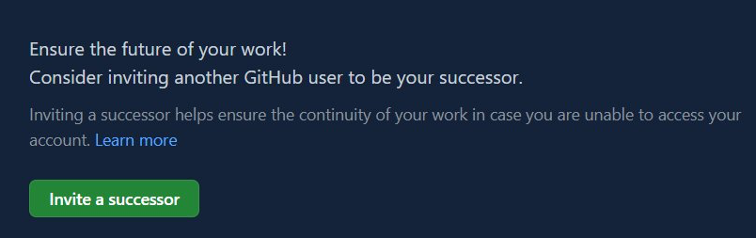
Bus Factor & Importance of Information Sharing
Notes:
In the context of teams and team performance, one important metric to consider is the bus factor: which is to say, how many members of your team are entirely irreplaceable, the sole holders of particular, specialized knowledge?
If your team can only operate because of one developer who knows in detail how your system works (and this is not documented anywhere), if that developer “gets on a bus” (and doesn’t come back), can your team recover? Effective teams formalize this important knowledge, ensuring resiliency in the event that a team member leaves the group for a variety of reasons (be it to get a new job, or simply moving based on personal constraints).
This is particularly important in the context of your team project, because students drop the course, get sick, etc., leaving you with a team of 3 instead of 4. Usually about 25% of our teams wind up in this situation.
(Build)
GitHub has recently started to track projects that are popular, but have a bus factor of 1 - projects with a single maintainer, creating a notification and using this language of “inviting a successor” in case “you are unable to access your account” – but being locked out of your account is just another way that this problem can present. You really do not want a bus factor of one.

Slide 11

How does your team respond to failures?
In software, in humans, and in processes.
How do we learn:
What went well?
What went wrong?
Where we got lucky?
How do we prevent it from happening again?
Notes:
Putting out fires is a topic for another lecture. The part that is relevant for our discussion of teams, and is probably the most important thing for the future is:
…how to learn from mistakes.
How do you learn from mistakes? We usually want to learn what went well (what worked?), what went wrong (obviously the house caught on fire, but why?), where we got lucky (the fire department was already close!), and how we can prevent this from happening again.

Slide 12
Blameless Post-Mortems
What actions did you take at the time?
What effects did you observe at the time?
What were the expectations that you had?
What assumptions did you make?
What is your understanding of the timeline of events as they occurred?
Notes:
The process of reflecting on and learning from these mistakes can be formalized into a “post mortem” review
In order to figure out what went well, what didn’t, and where we were lucky, we need answers to all of these questions.
A good slogan is “Fix the problem, not the blame”.

Slide 13
How Not to Respond to Failures
Some engineer contributes to failure or incident
Engineer is punished/shamed/blamed/retrained
Engineers as a whole become silent on details to management to avoid being scapegoated
Management becomes less informed about what actually is happening, do not actually find/fix root causes of incidents
Process repeats, amplifying every time
Notes:
How can we get true answers if there is fear of punishment or retribution?
Engineers might misrepresent the actions that they took to make themselves look better, or play dumb about the effects that they saw.

Slide 14
Learning Goals for this Lesson
At the end of this lesson, you should be able to
Understand why agile processes favor small teams
Describe the HRT pillars of social interaction
Explain the importance of sharing information with your team
Understand how to do a blameless post-mortem of a failure.
Notes:
<read slide>

